Slide 1
VBA Seminar

Slide 2
What to get out of this seminar
Understanding of basic coding concepts
Understanding of how VBA manipulates cells in Excel
Provide you with the tools to explore further
All materials are in:
shorturl.at/elnxY
Download the .xlsx dataset and this powerpoint to take notes

Slide 3
Table of Contents
Introduction
Who am I
Comparison of Languages
VBA
Set up your personal macro workbook
Variables and Datatypes
Building Blocks of a vba program
if/for/function/sub
Cell manipulation
Putting it all together
How to use record macro effectively
How to use debugger in VBA

Slide 4
Introduction
Who Am I:
B.Sc (Major in Psychology/Biology, McMaster)
MBA (Data Analytics Stream, Brock)
Self taught programmer
Worked at RBC as a data analyst and developer
Teams: myMobility, Credit Modelling, FRTB IT
Languages: Python, Scala, VBA, SQL, Java
RBC is a great company that is generous with their money

Slide 5
Introduction
Comparison of Languages
 | Python | VBA (Visual Basic for Applications) | SQL (structured Query Language) | Java | Scala
Pros | Extremely versatile language Clean and easy to understand Hot language for years to come Open source language | Automate every single thing that requires manual processing Can be used to build interactive prototype applications with UI quickly | Every single database in the world uses some flavor of SQL (including Hadoop ecosystem) Transferrable language in any job related to data | - Extremely versatile language Can be run on any machine that has a JVM (compiler) Ton of material on best practices | Python like functional feel Clean and somewhat easy to understand Specifically for Hadoop ecosystem (runs fast on Hadoop)
Cons | Amount of pre built packages and methods can be overwhelming Difficult to build prototype applications with UI | Only applicable to Excel Only Integrated development environment (IDE) available is in Excel MS does not support this language anymore (no more features) | Limited in the things you can build with SQL Can’t prototype applications Hard to debug | Difficult language to learn Strict language protocols that you must follow | Tedious to setup (requires Hadoop infrastructure, no local computer support) Can be hard to debug
Learning (Basics) | Easy | Medium | Easy | Hard | Medium

Slide 6
Lets talk about VBA (personal experience only)
Visual basic for applications is extremely useful where:
You need to automate data cleansing (class activity) or joining processes (not part of today’s activities)
Rapidly build applications with a user interface (Quick Demo at end)
Formatting a report (building charts or making something look pretty)
Simple calculations (+/-/divide/multiplication, KPI, ratios)
Where VBA sucks:
Dataset larger than excel limit (~1 mil)
Realistically, your script will run slow at around 500k rows but it depends on complexity of script
Be aware of how big your data is, VBA is meant for medium sized data
Anything beyond, Python is a much better tool
Any kind of complicated math calculation (ML Models)
You simply do not want to code this in VBA (too complicated without built in packages)
Awkward class constructions (don’t worry about this if you don’t want to dig too deep into programming)

Slide 7
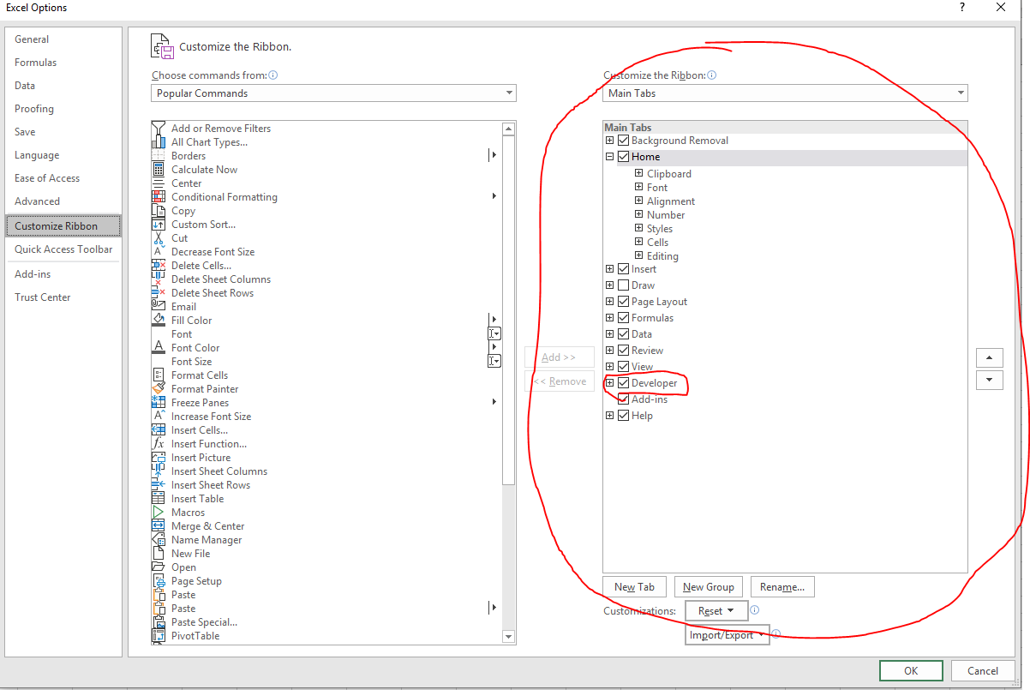
Set up your personal workbook (1/2)
Do the following:
File ➔ Options ➔ Customize Ribbon ➔ Developer ➔ Customize Ribbon ➔ Check off the Developer option ➔ OK

Slide 8
Set up your personal workbook (2/2)
Do the following:
Click on Developer tab ➔ Record Macro ➔ Store Macro in: Personal Macro Workbook ➔ OK ➔ Stop Recording
Check if you have your personal macro:
Click on Visual Basic
Should have something that looks like this:

Slide 9
Variables & DataTypes (1/3)
Variable is a placeholder for a value of some kind
Datatypes tell the computer what kind of value the variable can hold
Today we will deal with:
Integer
String
For more info:
https://www.automateexcel.com/vba/data-types-variables-constants/

Slide 10
Variables & DataTypes (2/3)
The basics:
Dim ➔ “Dimension” aka “declare”
As Integer or As String ➔ tells what type of variable it is
Tips & Tricks:
Autocomplete: works differently depending on which language and development environment you work in
For VBA: type everything in small letters, the application will auto capitalize key words (i.e. As, Integer, Dim)
Once you dim a variable, you can also autocomplete the variable by pressing ctrl + space
This does not work if you don’t dim the variable which you don’t have to in VBA
As you type a keyword, VBA will sometimes autocomplete it, press tab to select it
Best practice: Always dim your variable
Note: VBA is ancient, it has the most archaic autocomplete mechanisms

Slide 11
Variables & DataTypes (3/3)
The Immediate Window:
View ➔ Immediate Window OR Ctrl + G
A space where you can quickly see what your variables are doing
Debug.Print some_variable
Prints out the thing that you want in the immediate window

Slide 12
Building Blocks of a vba program [if/for/function/sub] (1/7)
If statement syntax:
if this_condition_is_true then
run_these_statements
end if
Use else if when you have a second condition (part of a larger if statement)
Use else when you want a catch all condition (part of a larger if statement)
For statement syntax:
for iterator = some_number
run_these_statements
next iterator
Iterator ➔ a variable to tell the program which loop you are on
Function returns a value while subroutines (Sub) doesn’t (for this class, you don’t need to worry about function)
https://www.excel-easy.com/vba/function-sub.html
Class activity (Sub if_example(), Sub loop_example())
Note: Language specific operators are extremely important to know any remember!
https://www.tutorialspoint.com/vba/vba_operators.htm

Slide 13
Building Blocks of a vba program [if/for/function/sub] (2/7)
Tips and Tricks
Just because you used an iterator to initiate a loop, it doesn’t mean you have to use it in the actual loop
Best Practice: You should not declare iterator variables as these are typically only used within the loop itself

Slide 14
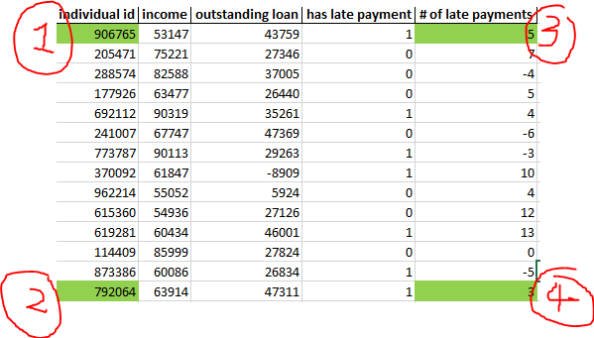
Building Blocks of a vba program (cell manipulation) (3/7)
“I want to loop through the entire dataset and do something with each individual cell”
What you need: Location of first cell and location of last cell with data + For loop
Location of first cell: Cell(2,1) ➔ Circle 1
Cells (row #, column #)
Location of Circle 2? ➔ cell (row #?, 1)
How do we determine the row#?

Slide 15
Building Blocks of a vba program (cell manipulation) (4/7)
How do we determine the row# of circle 2?
To get the location of circle 2 in terms of its row use the following syntax:
Cells(rows.count,1).end(xlup).row
Cells(rows.count,1) ➔ This is the current active cell which is the last cell # of column 1
.end(xlup) ➔ press ctrl + up, this is now the current active cell
.row ➔ give me the row number of the current active cell
Class example (Function xlup_example())
What would you change if you wanted to find the row # of Circle 4 instead of Circle 2?
The column number! Cells(rows.count,1)

Slide 16
Building Blocks of a vba program (cell manipulation) (5/7)
What if the number of columns are also changing?
To get the location of circle 3 in terms of its column use the following syntax:
Cells(1,columns.count).end(xltoleft).column
Cells(1,columns.count) ➔ This is the current active cell which is the last cell # of row 1
.end(xltoleft) ➔ press ctrl + left, this is now the current active cell
.column➔ give me the row number of the current active cell
Class example (Sub xlleft_example())
What would you change if you wanted to find the column # of circle 4 instead of circle 3?
The row number! Cells(1, columns.count,)

Slide 17
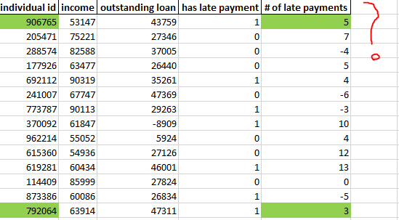
Building Blocks of a vba program (cell manipulation) (6/7)
How do we programmatically add to existing cells?
Cells (row #, column #) = “Some value”
There are many, many, many things you can do in terms of built in cell manipulation (Changing colors, size, borderlines…etc)
Class Acitvity populate_cell_example()

Slide 18
Building Blocks of a vba program (cell manipulation) (7/7)
Summary:
Dynamically find last row for a given column:
Cells(rows.count,1).end(xlup).row
The column # doesn’t matter if you know that the last row of your dataset is always filled
Dynamically find last column for a given row (usually the header):
Cells(1,columns.count).end(xlup).row
Only applies in situations where the # of columns changes over time
There are times when you need both
Class activity

Slide 19
Putting it all together (1/7)
There’s something wrong with the dataset!
(1) # of late payments can’t be negative
(2) Recode “has late payment” (0 and 1 are hard to read)
(3) If a person never had a late payment, then they shouldn’t have a value in # of late payments
Thinking through the problem:
Should we use VBA + Excel?
Should we use pure Excel/VBA?
Best Practice: Always try to do it via Excel only and see how much time and complexity it has. Use best judgement when determining what process to use. Remember, if the time to code is exponentially greater than a 5-10 minute process that only runs once per week/month, it’s probably not worth it.
Code updates and readability are major considerations

Slide 20
Putting it all together (2/7)
(1) # of late payments can’t be negative
Use an if statement ➔ Sub no_negative_payments()
If # late payment column is less than 0, then make it 0
(2) Recode “has late payment” (0 and 1 are hard to read)
Use an if statement ➔ Sub recode_late_payments()
If has late payment is 0, make that cell “n”
If has late pay is 1, make that cell “y”
(3) If a person never had a late payment, then they can’t have # of late payments
Use an if statement ➔ Sub correct_late_payments
If the has late payment equals to “n” then the “# of late payments” should be 0
Why do we need a loop?
We want to tell the computer which cell to manipulate which, in our case, is every cell in a given column
How should we actually run all these 3 subroutines in order?
Possible ways: (1) Write everything in a giant function and run (2) Write the three functions and call the other two functions from the first function (3) Write a function that calls the 3 functions
Best Practice: Use a Sub Main that calls the functions (choice (3))
Comes from Java Protocol

Slide 21
Putting it all together (3/7)
Class exercises
Lets add another business rule
No outstanding loan can be negative and if it is, make it positive
Lets add a KPI!
Income/Outstanding Loan Ratio (New column ➔ Inc/Outanding)
Label the ratio as bad, good, great, excellent (New column ➔ Inc/Outstanding)
Put it all into your main!

Slide 22
Putting it all together (4/7)
For i = 2 To Cells(Rows.Count, 5).End(xlUp).Row
If Cells(i, 5) < 0 Then
Cells(i, 5) = 0
End If
Next i
i = 2 ➔ “Start on row 2”
Cells(Rows.Count, 5).End(xlUp).Row ➔ “end at the last row # with data in column 5”
Next i ➔ “go to the next row”

Slide 23
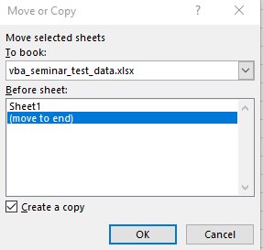
Putting it all together (5/7)
Lets code!
Golden rule when working with macros: Always keep a copy of your original data via right clicking on the worksheet ➔ selecting move or copy ➔ “create a copy” ➔ “move to end” ➔ OK ➔ Rename the new worksheet to something intuitive

Slide 24
Putting it all together (6/7)
What if my dataset’s column is not stable (i.e. the column “# of late payments” name will not change BUT it might not always be on column 2) . You will need 2 for loops.
Dim num_late_payments as Integer
‘First for loop: I want to first find the column number called income_col_num
For col_num = 1 To Cells(1, columns.count).End(xltoleft).Column
if cells(1,col_num) = “# of late payments” then
num_late_payments = col_num
end if
Next col_num
col_num = 1 ➔ “Start on column 1”
Cells(1, columns.count).End(xlUp).Row ➔ “end at the last column # with data in row 1”
Next column_num ➔ “go to the next column”

Slide 25
Putting it all together (7/7)
‘second for loop, I want to manipulate the cells in “# of late payments”
For i = 2 To Cells(Rows.Count, num_late_payments).End(xlUp).Row
If Cells(i, num_late_payments) < 0 Then
Cells(i, num_late_payments) = 0
End If
Next i

Slide 26
How to use record macro effectively
Record Macro is good for:
When you don’t know the syntax for a process (i.e. Highlighting, adding a borderline)
When the data never changes, you can record macro and run the macro over and over again
Let’s add on to our code!
We now want to highlight the fishy rows but we don’t know the syntax for highlighting
Class Activity

Slide 27
How to use record macro effectively
Bonus 1: What if we just want to mark down the rows we think are fishy but not actually change the dataset?
Bonus 2: What if we just want to mark down the rows we think are fishy but not actually change the dataset?

Slide 28
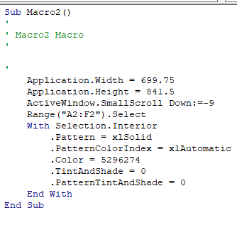
How to use record macro effectively
We don’t need everything, cut down on the code.
Lets focus on the green box
If we run this, it only applies to cells from A2 to F2, therefore we need to fit this code for our needs
What it’s doing:
Selects a range of cells ➔ colors the cells (with Selection.Interior …)
Specifically in “Range” we need 2 cells which is the start and end
How do we fit this into our code?

Slide 29
How to use record macro effectively
Copy and paste the relevant code into the existing code that we already have
Replace the (“A2:F2”) with cells(row#,col#) separated by a comma
You’re done!
Class Activity: Lets put a border around it!

Slide 30

How to use debugger in VBA
Debugger is extremely extremely useful:
Allows you to step through the program and see what each variable does and what the value of each variable is
Can correct the program on the fly instead of coding the wrong things and then only discovering at run time that it’s wrong
Press F8 to step through the program
Yellow line is the current line that you are ABOUT to run
Hoover over any variable to see its value
You can drag the yellow arrow to whatever line you want to run, including ones that you ran already
Breakpoints ➔ A point where your program breaks if you press the run button
How to:
Press the margin of the line that you want to break
Useful when:
You have a huge program and you want to see specifically how one part of the program runs
If you want to see that chunk of code worked, point the break point right after the
Use the Immediate Window to see what your variables are doing

Slide 31
How to use debugger in VBA
Class Activity (This is difficult)
What if I want to loop through every single cell? You will need 2 loops.
Loop 1 will go through each column. Loop 2 will go through each cell.
In words:
Start with Column 1, go through each row of column 1
When (A) is done, go to Column 2, go through each row of column 2
When (B) is done, go to Column 3, go through each row of Column 3
Try it yourself!
To start you off…
For col = 1 to cells(columns.count,1).end(xltoleft).column
for row_num = 2 ….
Debug.Print (“We are now on row #” & row_num & “of column “ & col_num)

